Slide 1
Fluocell Demo
Qin Qin

Slide 2

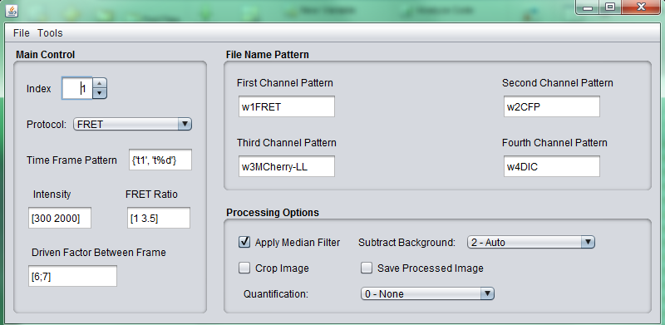
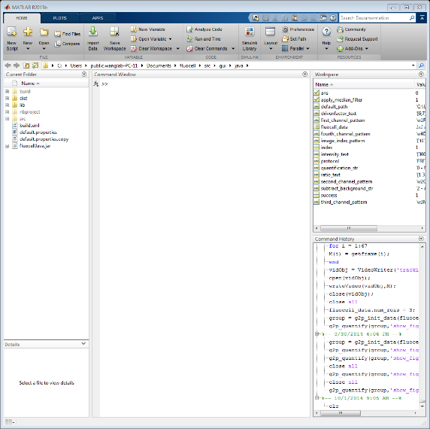

Fluocell GUI
Step 1: close current MATLAB and use Fluocell to call out MATLAB

Slide 3
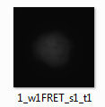

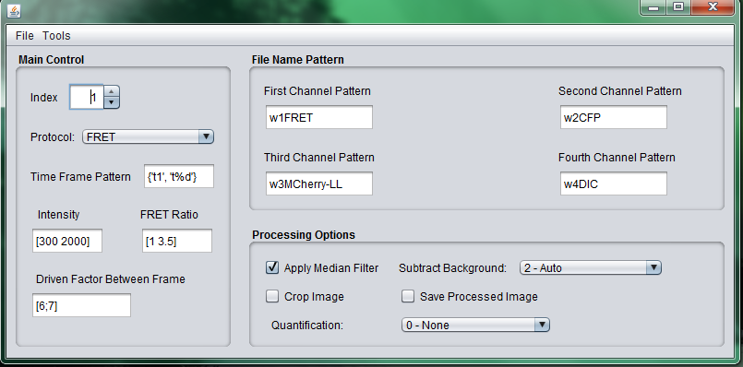
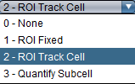
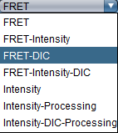
Fluocell GUI
Step 2: adjust the setting on the fluocell interface:
0 – no background subtraction
1 – manually choose background
2 – automatically choose background
0 – no quantification
1 – quantification on fixed ROI
2 – quantification on tracking ROI
3 – quantification on subcellular scale
In which cycle you add stimulus, e.g. pdgf
FRET: normal use;
FRET-Intensity: FRET + another intensity(e.g. MCherry) channel
FRET-DIC: FRET + DIC channel
Proper setting on this two window will give a better hint on viewing
If you want to save ratio images

Slide 4
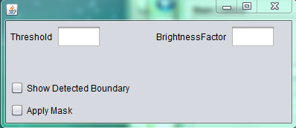

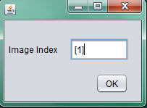
Fluocell demo
1.0
[1 : 50]

Slide 5
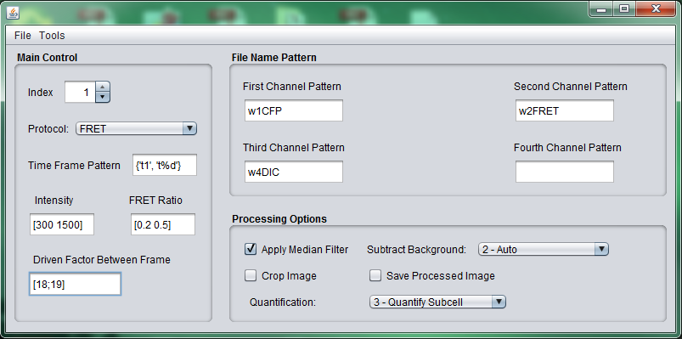
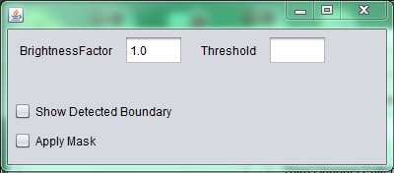
Visualize the ECFP/FRET Ratio Images

Slide 6
Visualize the ECFP/FRET Ratio Images

Slide 7
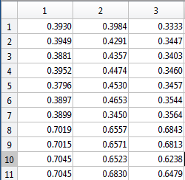
Quantification Using Regions of Interest (ROIs)

Slide 8

Quantification Using Regions of Interest (ROIs)

Slide 9
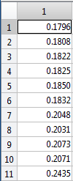
Quantification Through Cropped Image
* Whole cell detection used here, ROI is also available

Slide 10
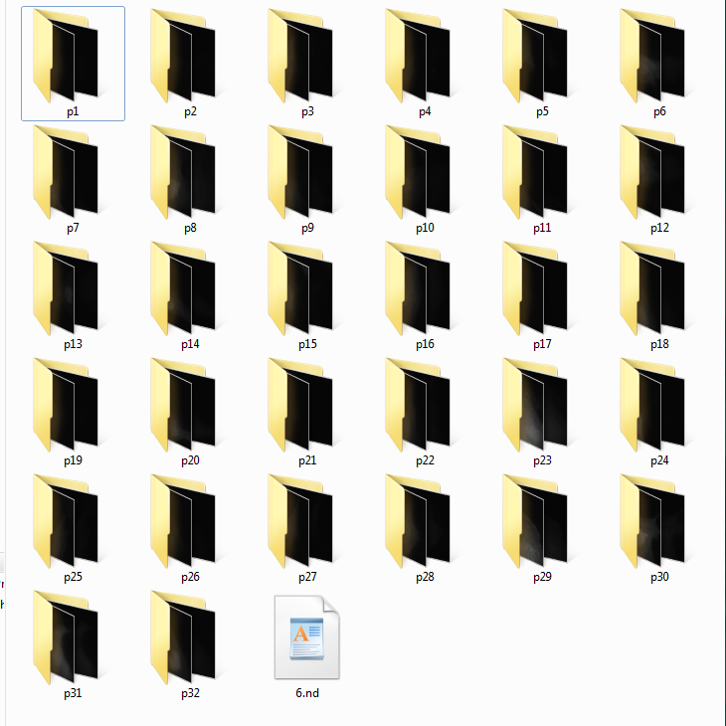
Multiple Quantification Through Whole Group

Slide 11
Multiple Quantification Through Whole Group
>> fluocell_data.num_layers = 3;
>> group = g2p_init_data(fluocell_data, 'group_data', []);
g2p_init_data: Update from fluocell_data since there is no input of group data or the data file.
g2p_init_data: Please make sure the fluocell is reading images from the p1 position.
pdgf time = 643.100000

Slide 12
Multiple Quantification Through Whole Group
>> group_image_view(group, 'time_point', [1 15 30 45])
‘group’ data structure as a main input
Parameter given by the user, which are the time points to check

Slide 13
Multiple Quantification Through Whole Group

Slide 14
Multiple Quantification Through Whole Group
>> g2p_quantify(group, 'show_figure', 0);

Slide 15
Multiple Quantification Through Whole Group
>> group_plot(group,'method',3, 'save_excel_file', 1, 'sheet_name', 'Cytosolic', 'tag_curve', 1);

Slide 16
Multiple Quantification Through Whole Group
Message on the command window of MATLAB:
The positions chosen here are p17 and p8, Do you want to delete them? Y/N [N]: y
Interaction between user and Fluocell
Y or y, Fluocell will help move the whole position to the output folder parallel to positions (not really delete the information)
N or n, nothing changed
Fast and accurately locate the bad curves based on the group plot

Slide 17
Multiple Quantification Through Whole Group

Slide 18
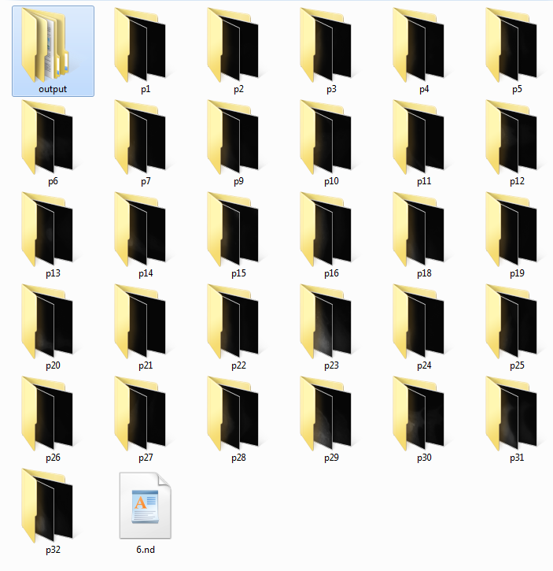
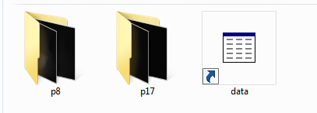
Multiple Quantification Through Whole Group

Slide 19
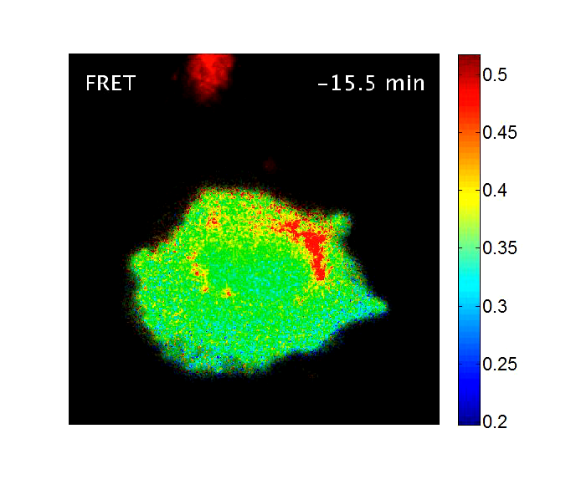
Multiple Quantification Through Whole Group
group_make_movie(group, 'color_bar', 1, 'position', 'p1', 'stimulus_info', 'pdgf', 'intensity_bound', [200, 1000]);

Slide 20
Multiple Quantification Through Whole Group
>> group_compare( group,'excel_file', 'fluocell-data.xlsx', 'error_bar_interval', 3, 'statistics','t-test', 'time_range', [20, 35], 'group_name', {'Cytosolic', 'Membrane'}, 'enable_violin_plot', 1);
Mean Ratio +/- Standard Error
For group Cytosolic(n = 30), 1.8139 +/- 0.0092795
For group Membrane(n = 37), 1.521 +/- 0.0037689
There is significant difference between Cytosolic and Membrane.
The p value is 4.6839e-07.
Mean Time +/- Standard Error
For group Cytosolic(n = 30),12.81 +/- 0.12711
For group Membrane(n = 37),21.3919 +/- 0.2292
There is significant difference between Cytosolic and Membrane.
The p value is 2.7984e-06.
Peak Ratio +/- Standard Error
For group Cytosolic(n = 30), 1.9917 +/- 0.0087202
For group Membrane(n = 37), 1.5704 +/- 0.0037993
There is significant difference between Cytosolic and Membrane.
The p value is 5.2375e-12.

Slide 21
Multiple Quantification Through Whole Group

Slide 22
Multiple Quantification Through Whole Group

Slide 23
Multiple Quantification Through Whole Group

Slide 24
Multiple Quantification Through Whole Group

